Slide 1
The TROPICS Mission Applications Program
Patrick Duran, Bill Blackwell, Vince Leslie
TROPICS EOPM
November 20, 2024

Slide 2
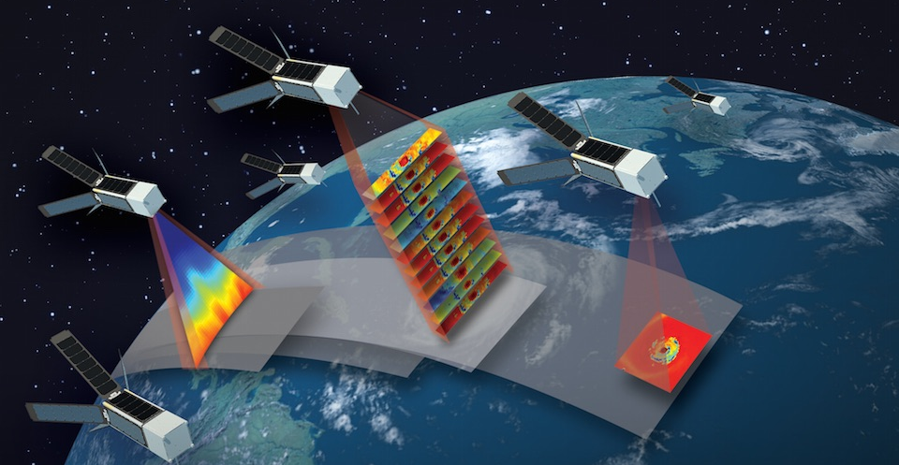
TROPICS Early Adopters: A Brief History
2017: First TROPICS Mission Applications Workshop
2018: Early Adopters Program Established by Brad Zavodsky; Emily Berndt becomes Mission Applications Lead (MAL) in December
2020: Second TROPICS Mission Applications Workshop
2021: Pathfinder launches; Patrick Duran becomes MAL
Spring 2023: Joint Applications Workshop for NASA’s CYGNSS and TROPICS Missions
Summer 2023: Constellation Launches
Under the leadership of three Mission Applications Leads (MALs) since 2018, the TROPICS applications program has steadily grown in size and scope.
MALs participate in mission science team telecons and act as a liaison between the science team and applications/stakeholder communities.
Feedback received at three applications workshops held in 2017, 2020, and 2023 has guided mission objectives and priorities.

Slide 3
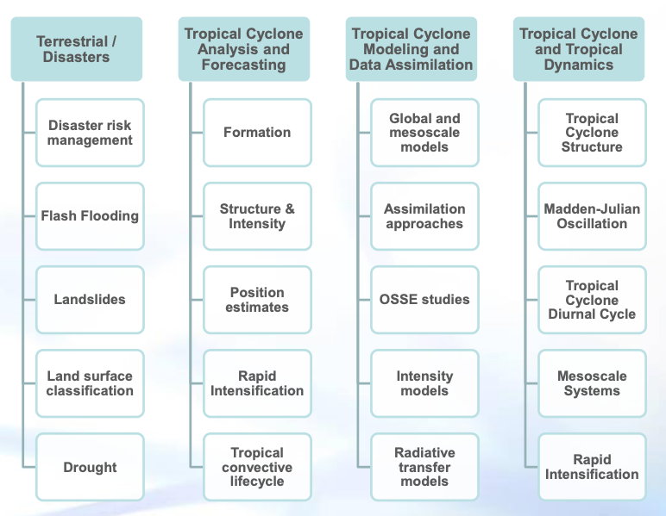
The TROPICS Early Adopters: Focus Areas
Guided by the first TROPICS Mission Applications Workshop, the TROPICS Early Adopters program was established in 2018.
The program is split into four primary applications focus areas (left) which benefit from TROPICS data.
Each early adopter submits a project proposal and is provided mission data upon acceptance into the program.
Quarterly teleconferences are held to update early adopters on mission status and discuss recent results.
Early Adopter Focus Areas (Figure courtesy Emily Berndt)

Slide 4
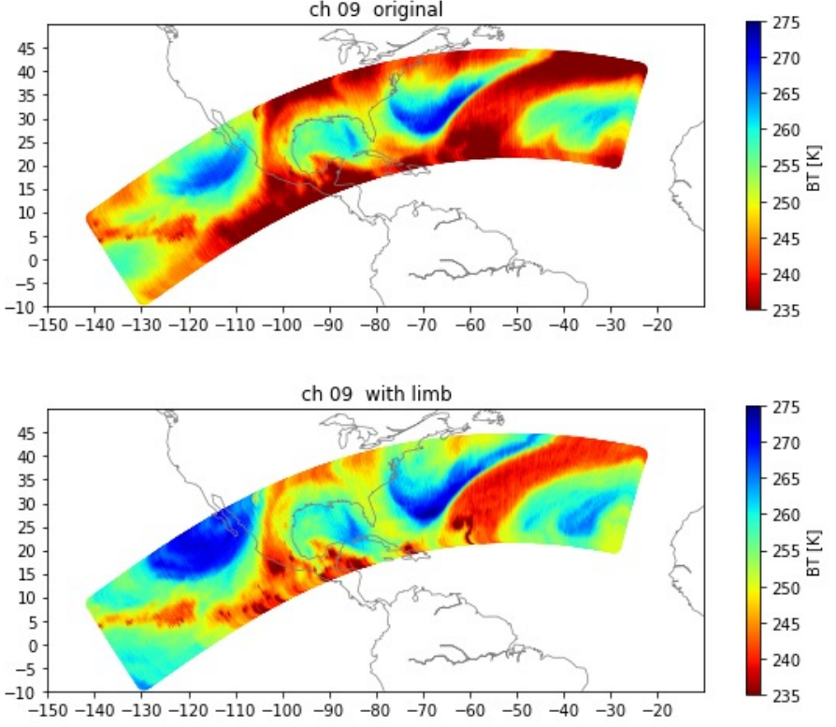
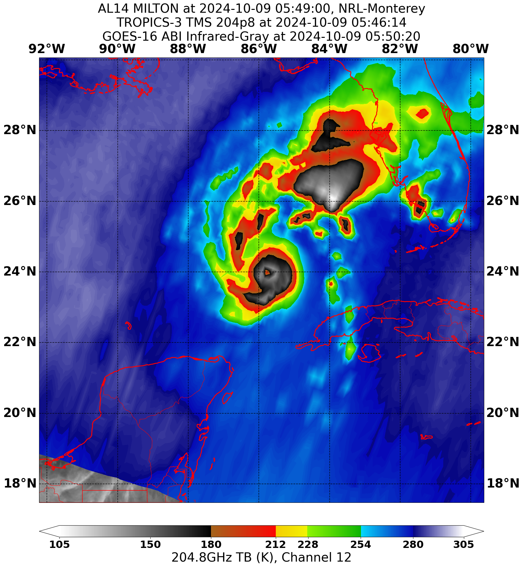
The TROPICS Early Adopters: Value and Growth
The early adopters community has grown steadily, with accelerating growth since leading up to launch 2021-2023.
Early adopters projects became more diverse, with new applications spanning beyond original topical areas.
Limb correction techniques for L1b data
Correcting for diurnal drift in temperature climatologies
Early adopters made TROPICS data widely available soon after launch.
Image courtesy
NRL
Image courtesy
Mitch Goldberg

Slide 5
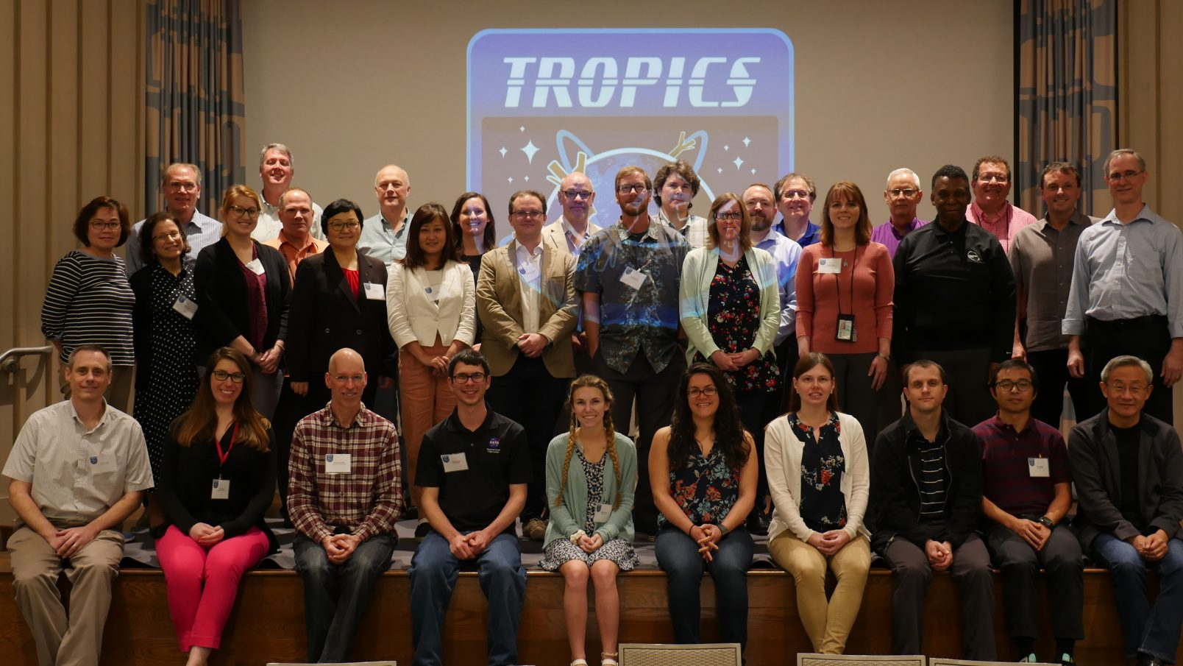
Second TROPICS Mission Applications Workshop
Goals:
Cultivate communication between early adopters by sharing results
Identify technical and visualization needs to enhance applications
Engage potential early adopters from the private sector
Some recommendations:
Seek partnerships with other government agencies to reduce data latency
Provide additional data formats (e.g., BUFR) for data assimilation
Launch a pathfinder vehicle prior to constellation launch to accelerate preparations for the mission
Incorporate TROPICS data into decision support systems at operational forecasting centers
Attendees at the TROPICS Applications Workshop, February 19-20, 2020 in Miami, FL

Slide 6
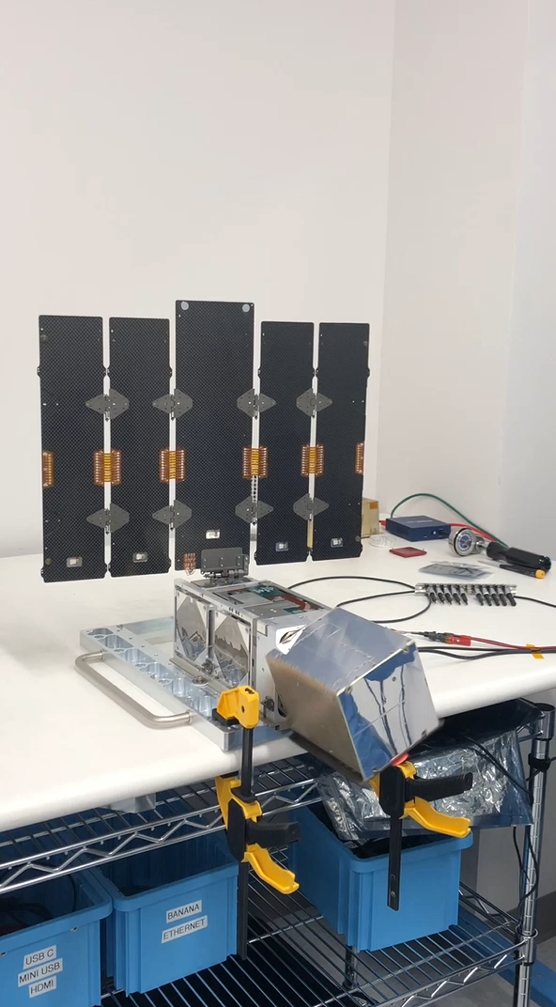
Pathfinder Launch and Low-Latency Efforts
The TROPICS science team responded to recommendations from the 2nd TROPICS Applications Workshop:
Launched the Pathfinder on June 30, 2021
Partnered with NOAA to conduct a low-latency experiment in April 2022 using the Pathfinder, successfully demonstrating low-latency operations
Secured funding from the Office of Naval Research to reduce Pathfinder latency to near 45 minutes.
NOAA and NASA ESD/Earth Action later funded low-latency operations for the full constellation in 2023 and 2024.

Slide 7
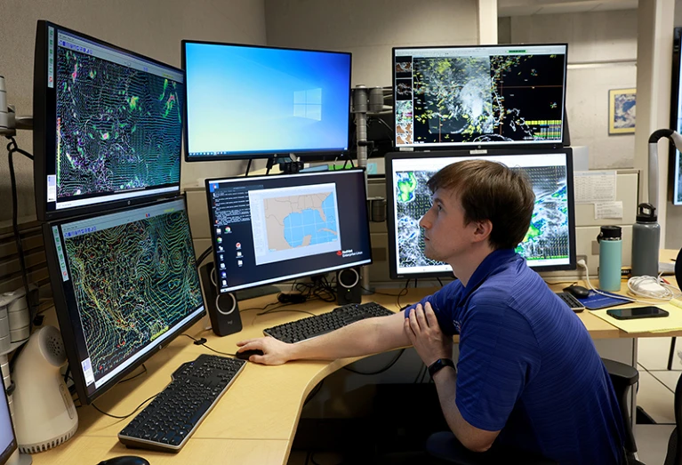
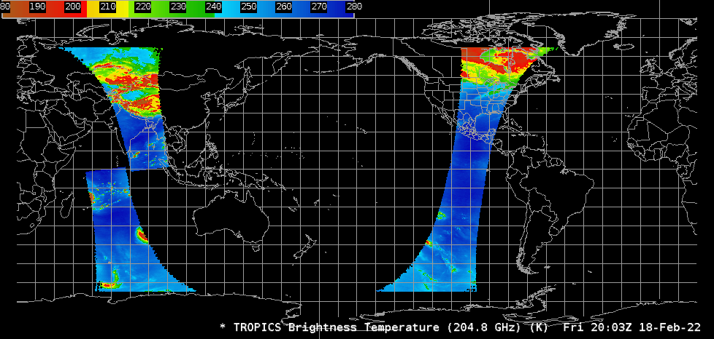
Data Formatting and Visualization
“TROPICS could significantly enhance our capability to better analyze the location and structure of these destructive storms in real-time.”
– Dr. Philippe Papin, Hurricane Specialist, National Hurricane Center
The TROPICS science team responded to recommendations from the 2nd TROPICS Applications Workshop:
Upon request from the operational modeling community, Data were formatted in the Binary Universal Form for the Representation of meteorological data (BUFR)
TROPICS brightness temperatures were formatted for display in the Automated Weather Interactive Processing System (AWIPS), which is used at the Joint Typhoon Warning Center, National Hurricane Center, and National Weather Service offices.
TROPICS
205 GHz
20:03 Z 02/18/22

Slide 8
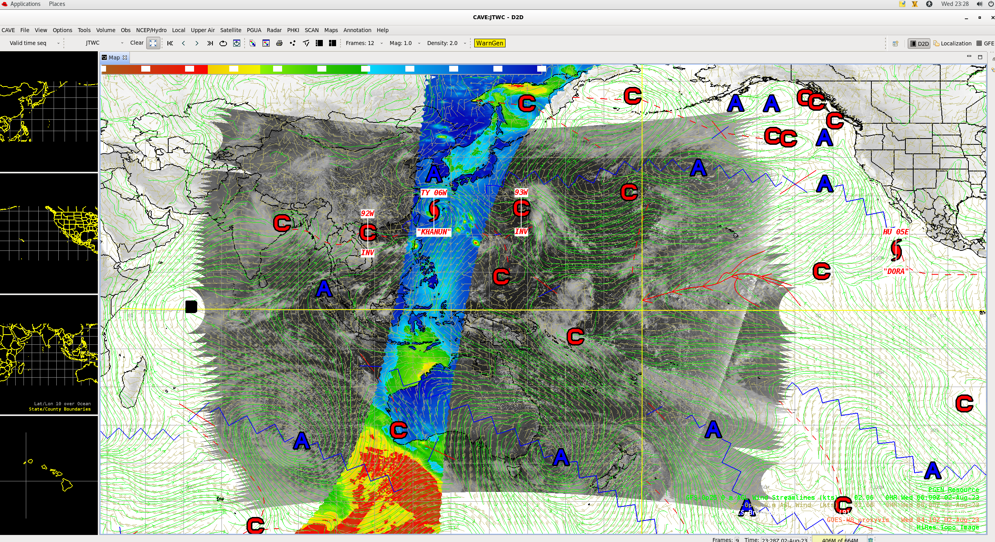
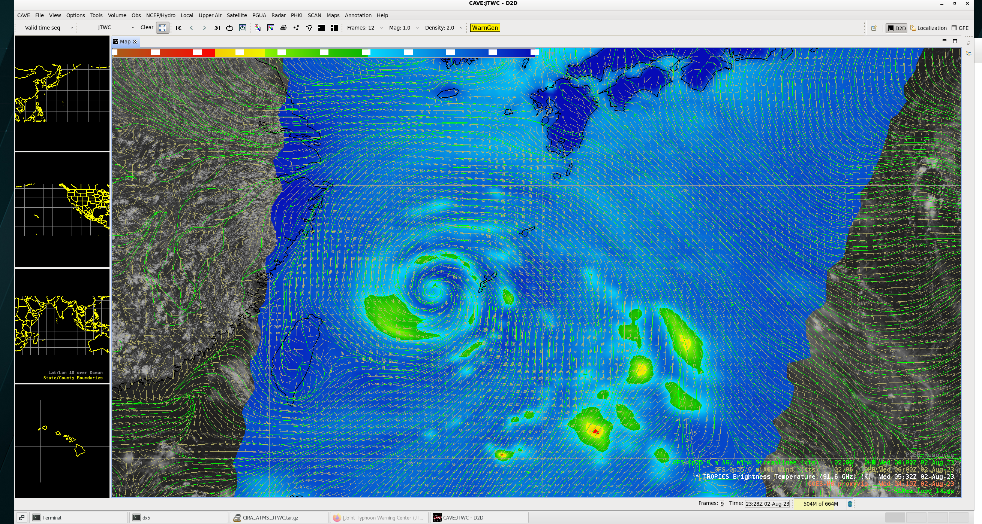
TROPICS Data Used in Operational Forecasting
Through collaboration with a TROPICS early adopter at the Joint Typhoon Warning Center (James Darlow), data were incorporated into JTWC’s AWIPS decision support system in 2023.
Screenshots provided by James Darlow show TROPICS Pathfinder data (filled colors) displayed in AWIPS, along with other data used for typhoon forecasting in the Western Pacific Ocean.

Slide 9
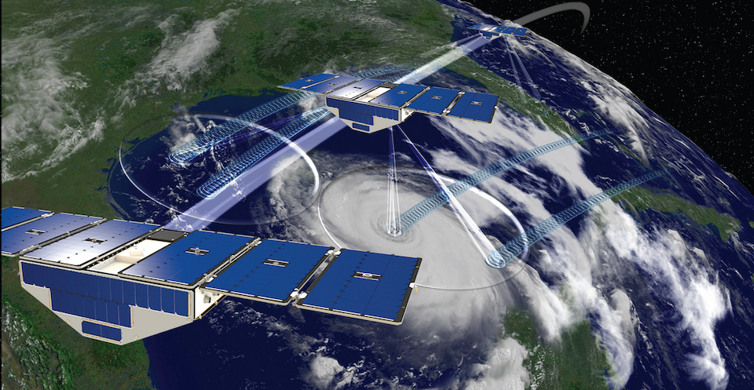
Joint Applications Workshop on CYGNSS and TROPICS
In 2022, an opportunity was identified to enhance collaboration between TROPICS and the Cyclone Global Navigation Satellite System (CYGNSS) mission:
Both are constellations of smallsats focused on observing the tropics in a complementary way
Clouds and precipitation from TROPICS; winds and inundation from CYGNSS
Joint workshop held April 11-13, 2023 in Miami, FL.
Representatives from 10 countries, 17 US states + DC, and six private-sector partners
Some goals:
Identify synergies between the two missions
Explore ways to expand collaboration with international and private-sector partners
Determine needs for high-level data products and training

Slide 10
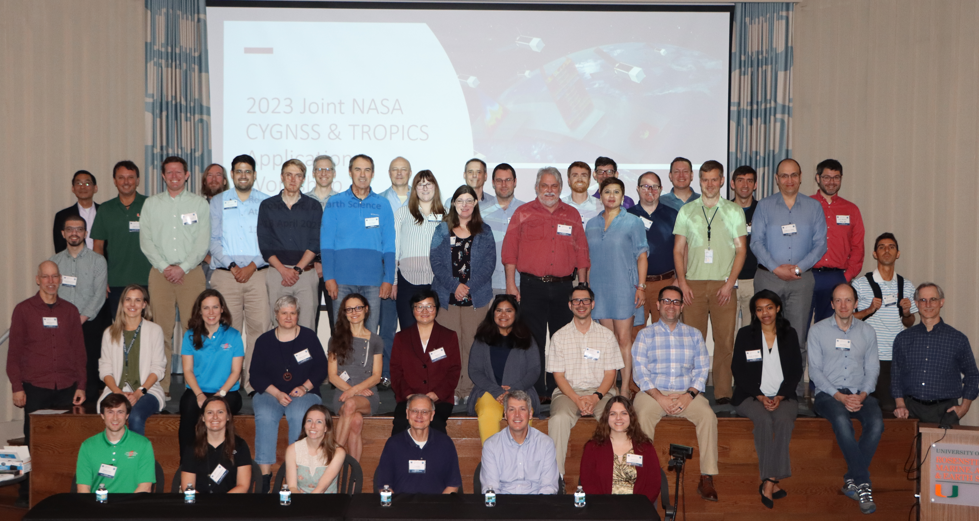
Joint Applications Workshop on CYGNSS and TROPICS
Some outcomes and recommendations
The CYGNSS and TROPICS science teams and applications communities should work together on synergistic topics:
Soil moisture, precipitation, inundation
Tropical cyclones and tropical rainfall
Data assimilation
Develop tools that facilitate intercomparison of data from multiple missions
Create Level 3 products for TROPICS to expand userbase
Engage with other national and regional weather forecast centers
Develop short- and long-form training to help researchers and forecasters make best use of the data

Slide 11
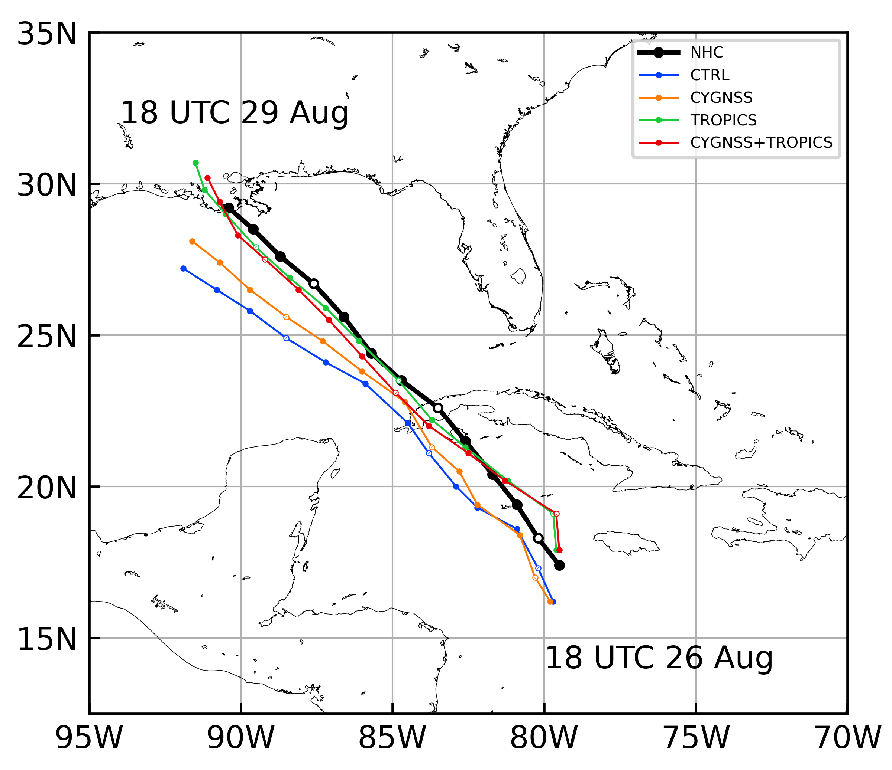
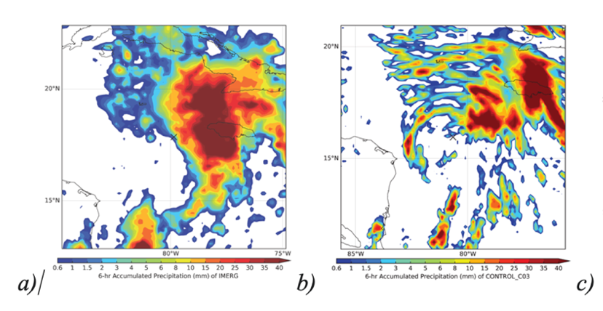
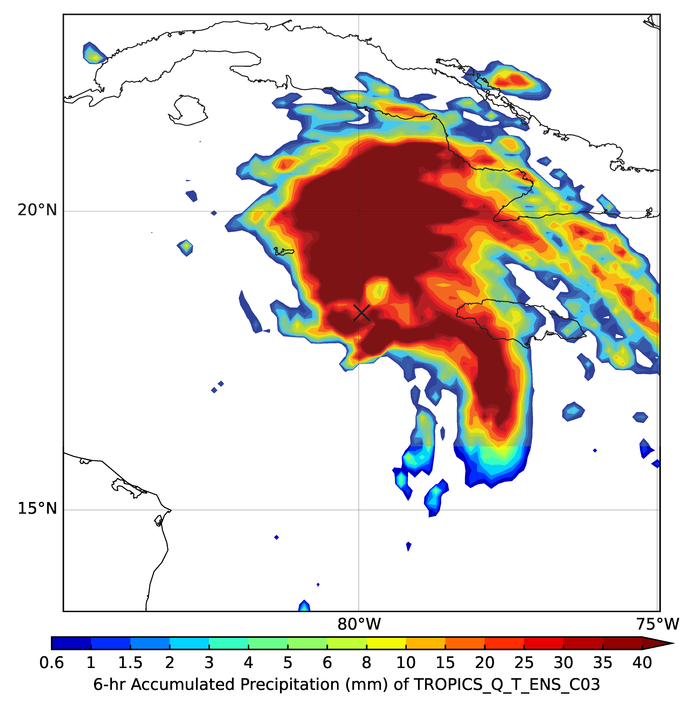
Efforts in Response to Workshop Recommendations
Recommendation: The CYGNSS and TROPICS science teams and applications communities should work together on synergistic topics
Response: Joint assimilation of TROPICS and CYGNSS data (led by Zhaoxia Pu)
Assimilating CYGNSS and TROPICS together improved the track and rainfall forecasts for Hurricane Ida (2021)
NHC
CTRL
CYGNSS
TROPICS
CYGNSS+TROPICS
IMERG
CTRL
TROPICS + CYGNSS

Slide 12
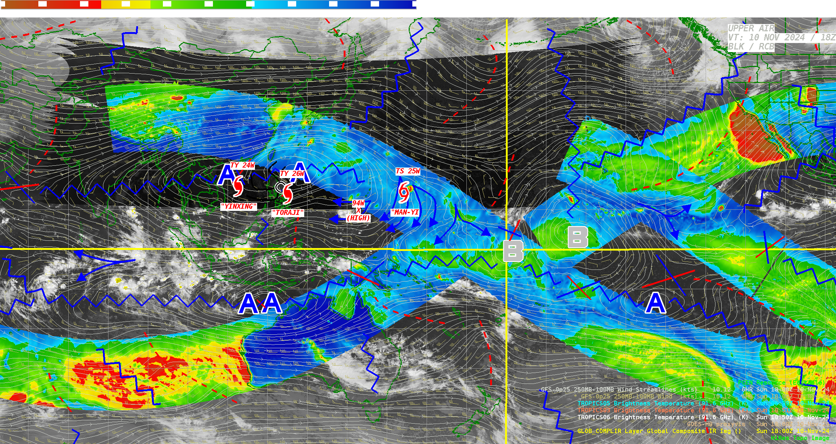
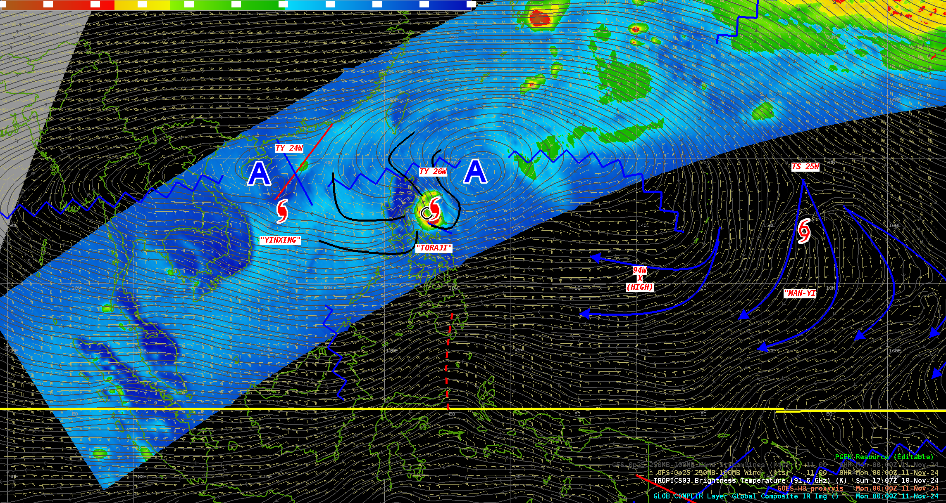
Efforts in Response to Workshop Recommendations
Recommendation: Develop tools that facilitate intercomparison of data from multiple missions
Response: Development of the Cyclone CataLog of Observations from NASA Environmental Satellites (CYCLONES) dashboard [Led early adopter Brent Roberts and funded by Christina Moats-Xavier.]
Recommendation: Develop short- and long-form training to help researchers and forecasters make best use of the data
Response: Development of quick guide training for forecasters to reference [Led by Mark DeMaria and Galina Chirokova]

Slide 13
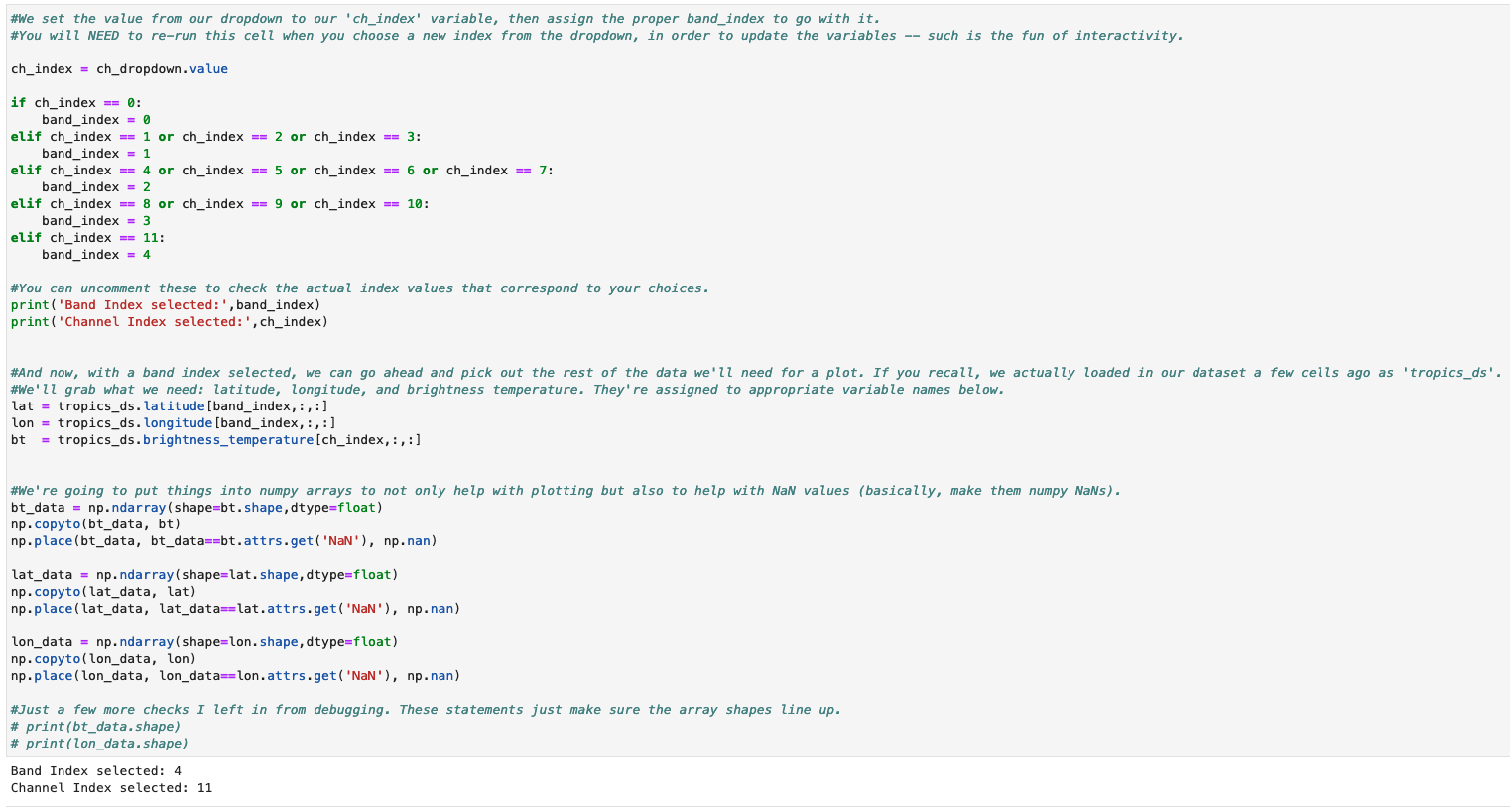
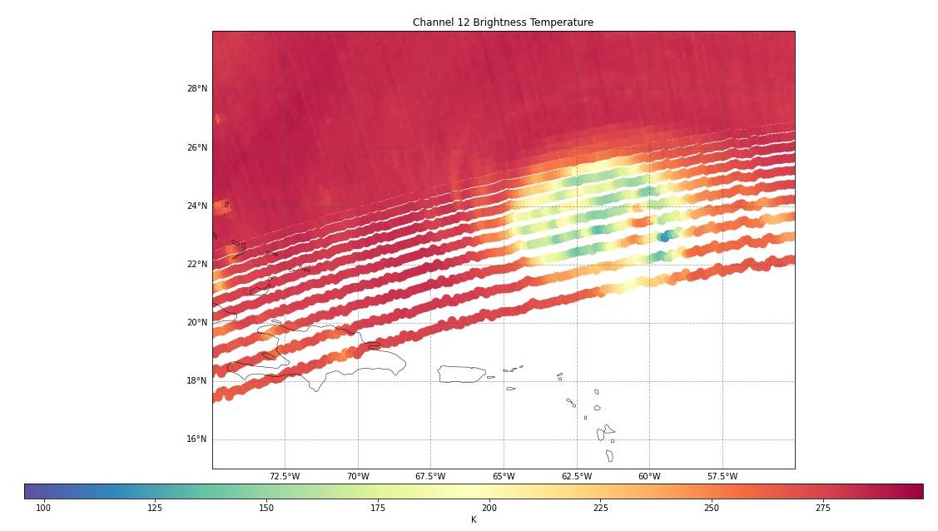
Looking to the Future
Consistent recommendation from Mission Applications Lead/Program Applications Lead workshops was the need to make NASA mission data more accessible to a broad audience of users.
NASA SPoRT is producing Jupyter notebooks that allow a user to quickly visualize and zoom in on TROPICS data, which will be linked to training resources currently under development.

Slide 14
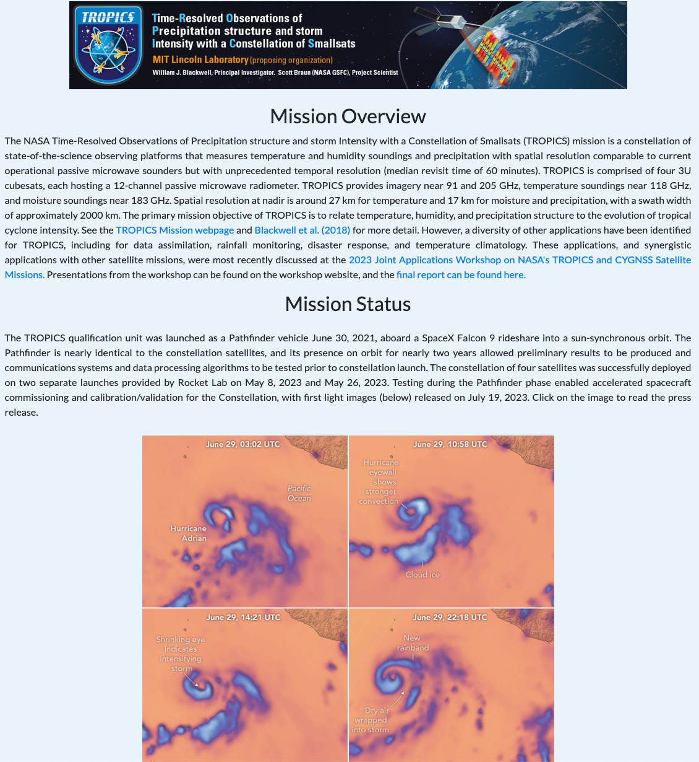
Success of the TROPICS Applications Program
Some final thoughts from the TROPICS Mission Applications Lead:
Since the TROPICS Early Adopters program was formed, the TROPICS PI and science team have actively engaged with the applications community.
The TROPICS team has been consistently responsive to concerns and requests from early adopters at every stage:
Actively participated in early adopters telecons
Successfully launched Pathfinder
Secured low-latency funding
Formatted data to maximize operational utility.
The TROPICS Applications program is continuing into FY25, with a focus on responding to recommendations from this year’s workshop
Updates will be posted at the Applications web page
https://weather.ndc.nasa.gov/tropics/

